Slide 1
Vocabulary & Listening

Slide 2
Recap
Skimming (Main idea or gist)
Scanning (Specific details)

Slide 3
Objective
Asking/Talking about significant events and experiences
Vocabulary (Informal phrases)
Listening 1
Listening 2
Reading 1

Slide 4
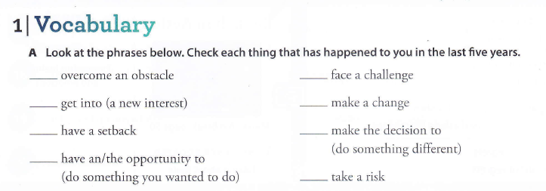

Slide 5
Listen to the audio (Make notes while listening)

Slide 6
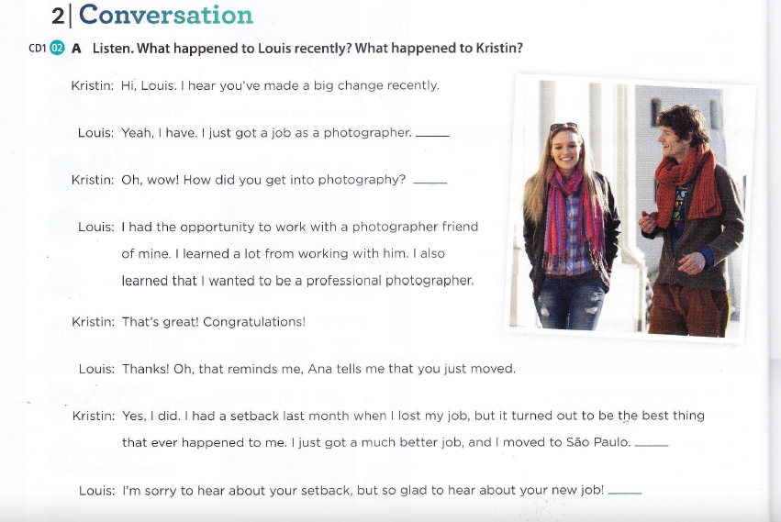

Slide 7
Find the best places to add the sentences given below to the conversation
1) I didn’t realize you were a photographer
2) I hope I can visit!
3) I love it!
4) I have always wanted to live there.

Slide 8
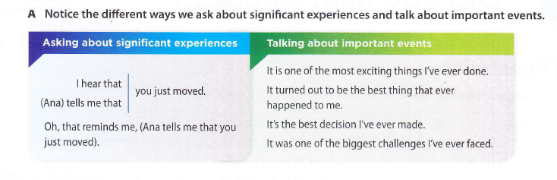

Slide 9
Listen to the audio (Make notes while listening)

Slide 10
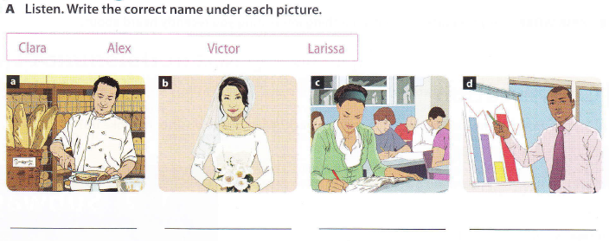

Slide 11
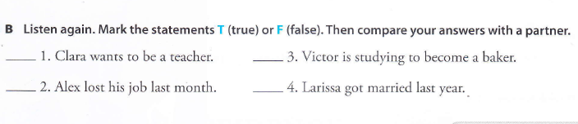

Slide 12
Reading
You will get three minutes to read a passage.
Make notes while you read.

Slide 13
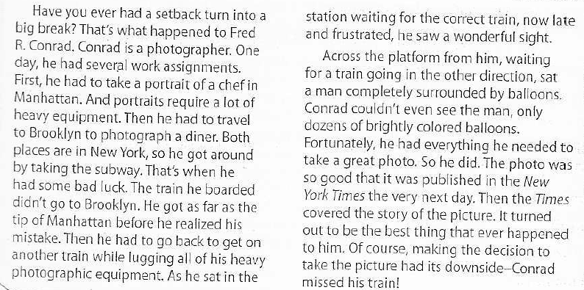

Slide 14
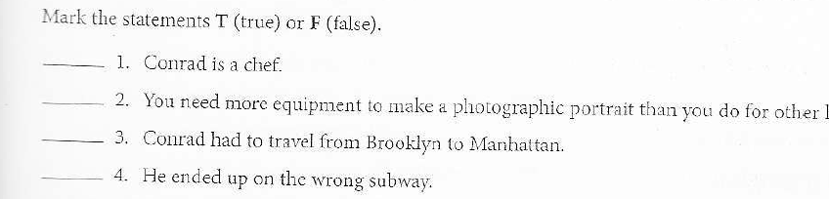

Slide 15
